Slide 1
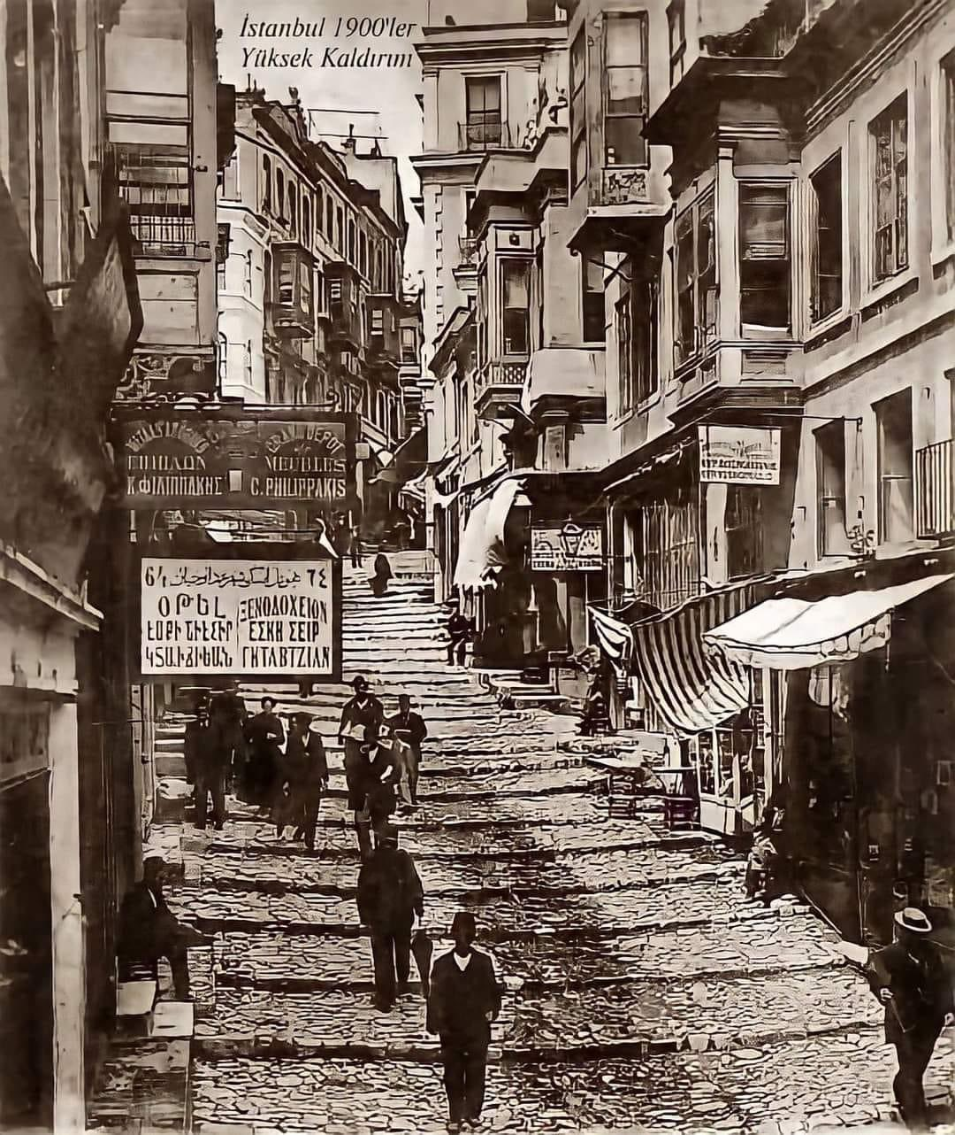
Relations Between the Greeks and Armenians of Turkey: From Greek Independence to the Present
George Meneshian

Slide 2

A few words about Parallel Fortunes
This book explores the complex 150-year history of Greek-Armenian relations, examining periods of cooperation, conflict, and shared experiences. It covers key events such as the Eastern Question, World War I, and the Greek-Turkish War, as well as the political, social, and cultural dynamics between the two nations. Highlighting both collaboration and tension, the study goes beyond traditional narratives to explore political alliances, diaspora interactions, and the impact of regional conflicts, ultimately offering a deeper understanding of the lasting ties between Greeks and Armenians.

Slide 3
Presentation Outline
Historical background.
Relations during and after the Greek War of Independence.
19th Century Cooperation & Competition
The Eastern Question
The Hamidian Massacres
From the Young Turk Revolution to World War I
Response to the Armenian Genocide
The Golden Age (1918-1922)
Post-Republic Relations

Slide 4
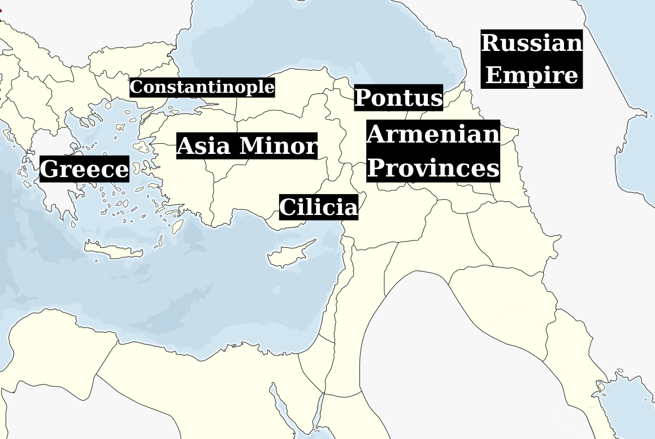

Slide 5
Historical background
Council of Chalcedon (451): Schism between the two churches, shaping future religious relations.
Armenians in the Eastern Roman (Byzantine) Empire:
Several emperors of Armenian origin played key roles in the Empire’s politics and military.
Creation of the Armenian Theme (Province).
Ottoman Millet System:
The millet system allowed religious communities (millets) to govern themselves.
The Rum and Armenian Millets: Greek Orthodox and Armenians had distinct, self-governing structures.
Armenian Patriarchate of Constantinople (1461): The leading institution of the Armenian community in the Ottoman Empire.
Mixed Greek and Armenian populations: Coexistence in major Ottoman cities, including Constantinople and Smyrna.
Dominance of the Rum Millet: The Rum millet was the dominant non-Muslim group, shaping Ottoman social and political life.

Slide 6
Relations during and after the Greek War of Independence.
Forced condemnation of the Greek revolutionaries.
The 1821 Constantinople pogroms.
Armenian support for the struggling Rums of Constantinople:
Financial contributions to the Ecumenical Patriarchate
Restoration of Greek Orthodox churches.
Efforts to free young Greek female captives taken during the massacres.
Replacement of Ottoman Greek bureaucrats with Armenians because of the weakening of Greek Orthodox influence.
The Greek War of Independence inspired the Armenians both in the Ottoman and Tsarist empires, igniting hopes for their own national liberation movements in the years to come.

Slide 7
19th Century Cooperation & Competition
The impact of the Tanzimat reforms (1839-1876).
Economic elites from both millets vied for control over trade and commerce in the Empire’s major cities, fostering competition.
Rise of nationalism.
Political and socioeconomic competition occasionally resulted in sporadic clashes between the Greek and Armenian communities, mostly in urban centres.
Cooperation between the Patriarchates but tensions among the Clergy:.
In 1864, the Armenian Patriarch founded the Greek-Armenian Union.
Most political figures in both communities were reluctant to take action against the Ottoman authorities, focusing instead on socioeconomic development and maintaining the status quo.

Slide 8

The Eastern Question Crisis (1876-1878)
For the first time, the Greek state showed a strong interest in the Armenian Question, improving relations between the Greek and Armenian communities within the Ottoman Empire.
Armenian and Greek (Rum) members of the Ottoman Parliament coordinated actions, reflecting growing cooperation.
Increased collaboration between the Greek and Armenian Patriarchates during the crisis.
The Greek and Armenian presses in Constantinople coordinated efforts, amplifying their shared concerns.
Both communities presented a unified agenda during the Constantinople Conference (1876-1877), though they lacked coordination at the Berlin Congress (1878).

Slide 9
The Hamidian Massacres (1894-1896)
The Pontic Greeks provided shelter to Armenians during the massacres.
Most Greeks refrained from reacting, fearing retribution from the Sultan. Some Greeks were also killed, and Greece’s inaction may have played a role in this response. There were some exceptions; a few Greek Orthodox bishops condemned the massacre of Armenian civilians.
Renewed diplomatic contact between the Armenian Patriarchate and the Greek embassy in Constantinople.
The secret Greek nationalist organisation "National Society" (formed in 1894) began cooperating with Armenian liberation movement representatives.
The massacres fostered closer relations between the Greek and Armenian communities, as noted by the Greek Ambassador to the Ottoman Empire and other diplomats.

Slide 10
From the Young Turk Revolution to World War I (1)
The Young Turk Revolution (1908)
Initially, tensions were low as Armenians supported the revolution, but this escalated into a violent incident in Constantinople, sparking a “war” between the Armenian and Greek press.
During the 1908 parliamentary elections, political factions competed fiercely, yet the two patriarchates found common ground in opposing Young Turk policies that undermined their religious roles.
A moment of reconciliation came with the creation of the Greek-Armenian Committee and the Greek-Armenian Society in late 1908.
Eventually, Greek and Armenian members of parliament began to cooperate, marking a new phase of collaboration, though it remained minimal due to Armenian reluctance.

Slide 11
From the Young Turk Revolution to World War I (2)
The Adana massacre (1909):
Local Greeks provided shelter to Armenians during the massacre.
Financial support was raised for displaced Armenians through fundraising and relief efforts.
Active Greek participation in the parliamentary committee investigating the massacre.
Support from the Ecumenical Patriarchate.
Religious dialogue aimed at the potential union of the two churches.
Continuous cooperation between the Greek and Armenian communities during and after the crisis.
The Balkan Wars (1912-1913):
Cooperation ended due to differing Armenian stances toward the war.

Slide 12
Response to the Armenian Genocide
The Armenian Genocide (1915-1918):
Greek consuls often did not distinguish between the persecution of Armenians and Greeks in their reports.
Greeks in Pontus provided shelter to Armenians, helped them escape, and supplied self-defence equipment to Armenian groups.
Reports of Greek individuals sacrificing themselves to protect their Armenian neighbors.
Despite threats from Ottoman authorities, Greeks continued to hide Armenians.
The Greek Orthodox ecclesiastical organisations played a crucial role in supporting Armenian victims of the genocide.
Some Greek diplomats hastily accepted Young Turk accusations of an "Armenian conspiracy," leading to mutual accusations of indifference between Greeks and Armenians.
Persecution led to increased solidarity between the two communities, with Greek and Armenian resistance groups forming joint defense units.

Slide 13
The Golden Age (1918-1922) (1)
According to I. Hassiotis, More was now done in the space of three years than had been achieved in half a century:
Emerging Alliance Between Greece and the Armenian Republic.
Creation of a joint patriarchal committee and submission of joint petitions to the Paris Peace Conference.
Orthodox priests fulfilled the religious needs of Armenians in the absence of Armenian clergy, despite doctrinal differences.
Joint religious ceremonies were held.
relief efforts for refugees and orphans following the war.
Armenian and Greek members of the Ottoman parliament jointly denounced the massacres of 1914–1918.

Slide 14
The Golden Age (1918-1922) (2)
Greek and Armenian newspapers in the city coordinated a joint propaganda campaign.
Greeks and Armenians held joint events and spontaneous celebrations.
Joint military efforts:
Collaboration in military efforts across Pontus, the Caucasus, Cilicia, and Asia Minor.
Formation of the Armenian Legion in the Greek Army.
Formation of the Greek-Armenian Committee in 1921 to further strengthen ties.
Pontic-Armenian relations: from shared struggle to eventual conflict.

Slide 15
Post-Republic Relations
The remaining Greeks and Armenians in Turkey faced the same challenges, as the Turkish state implemented identical policies toward both minority groups.
In 1942, while Greece was under the triple occupation of Axis forces, the Turkish authorities imposed the so-called Varlık Vergisi (Wealth Tax), a special levy that economically devastated the Greek, Armenian, and Jewish communities.
Armenians were also victims of the Turkish mob during the Istanbul Pogrom (Sep. 1955), despite the primary target being the Greek community due to tensions related to the Cyprus issue.
Armenians in Istanbul were not expelled like the Greeks in 1964, though some left due to mixed marriages.
Despite shared struggles, the two shrinking communities largely focused on their own internal issues.
Conditions for both communities improved after Recep Tayyip Erdogan came to power.
Regular meetings between representatives of the Greek and Armenian patriarchates, including the patriarchs themselves.

Slide 16
Concluding remarks
There were times of intense cooperation and shared struggles, but also periods marked by rivalry, suspicion, and conflicting interests between the two communities.
Doctrinal and ecclesiastical differences occasionally caused conflicts between the clergy of the two millets, but these conflicts rarely escalated to affect the Patriarchates themselves.
Greeks were among the few who supported the Armenians during the Hamidian Massacres, the Adana Massacre, the Armenian Genocide, and in the Armenians’ efforts to establish an independent state.
Relations between the two millets were strongly shaped by the Greek state's stance toward the Armenians and the Armenian Question.

Slide 17
Thank you for listening!
You can find me here:
Email: meneshiangeorge@yahoo.com
LinkedIn: George Meneshian
X: GMeneshian

